Slide 1
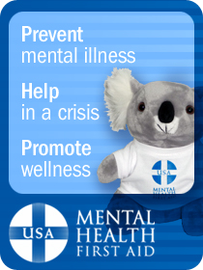
A “Taste” of
Youth & Adult
Mental Health First Aid
Presented by:

Slide 2
What Is Mental Health First Aid?
Help offered to a person developing a mental health problem or experiencing a mental health crisis
Given until appropriate treatment and support are received or until the crisis resolves
Not a substitute for counseling, medical care, peer support or treatment
Notes:
Actual Definition
Mental Health First Aid is the help offered to a person developing a mental health problem or experiencing a mental health crisis. The first aid is given until appropriate treatment and support are received or until the crisis resolves.

Slide 3
Why Mental Health First Aid?
Mental health problems are common
Stigma is associated with mental health problems
Professional help is not always on hand
  Individuals with mental health problems often do not seek help
Many people…
  are not well informed about mental health problems
  do not know how to respond

Slide 4


Program Milestones
Created in Australia in 2001
  (University of Melbourne)
Currently in 22 countries
Piloted in the U.S. in 2008
U.S. youth program pilot in 2012
Notes:
Countries include: Scotland, China, Canada, Finland, Singapore, Ireland, Wales, England, Cambodia, Japan, South Africa, Thailand and New Zealand

Slide 5




More than 150,000 trained
4,000+ instructors
National policy and media attention
Partnership with Maryland and Missouri State Governments

Slide 6


ALGEE-OMETER
Over 150,000 First Aiders in the US
Trained by 4,000 Instructors
AK
1,155
(36)
WA
3,785 (70)
MT
325 (7)
ME
176 (8)
ND
378 (5)
VT
394 (48)
OR
2,055 (63)
MN
2,188
(23)
ID
483 (12)
WI
573
(20)
NH
33 (2)
SD
1,242 (20)
MI
5,424
(116)
NY
2,996 (104)
MA
1,165 (44)
WY
82 (16)
RI
362 (8)
IA
7,240 (78)
PA
7,709 (252)
CT
2,659 (87)
NV
249 (27)
NE
540 (16)
IN
899
(56)
OH
1,419
(92)
NJ
1,048 (60)
UT
929 (30)
IL
8,258
(171)
CA
21,211
(561)
CO
8,424 (209)
WV
0 (2)
DE
65 (17)
KS
5,887 (98)
MO
11,733
(233)
KY
584 (15)
VA
2,996 (91)
MD
4,499 (285)
1,089 (27)
NC
2,514 (62)
DC
1,564 (51)
AZ
4,919 (116)
NM
3,644 (82)
OK
1,714 (27)
AR
796
(17)
TN
SC
260 (7)
Percentage OF
Population Trained
MS
1,319
(73)
AL
900
(42)
GA
3,204
(91)
0.1% or more
TX
6,650 (215)
LA
293
(3)
0.04%-0.099%
0.025%-0.039%
FL
2,089
(125)
0.01%-0.024%
GUAM
37 (1)
Less than 0.01%
No data
PR
206 (2)
HI
5 (1)
Reported through December 2013

Slide 7
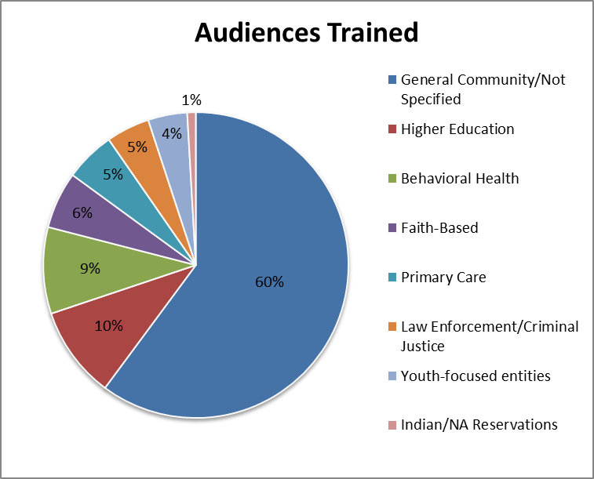
Notes:
General Community/ Not Specified:
School staff, youth groups, camps, parents, EAP, HR and Workplace Wellness
College and University
Faith Community
Government Employees and Elected Officials
Law Enforcement and Public Safety
Libraries
Social Service Agencies and Homeless Shelters

Slide 8





Mental Health First Aid in the News
October 10, 2011 | Morning Edition | by Kelly Weiss
Mental First Aid: How To Help In An Emotional Crisis
October 18, 2011 | Talk of the Nation | by Neal Conan
Mental Health First Aid in the Workplace
January 23, 2011 | by Michael Winerip
Positives With Roots In Tragedy On Campus
October 18, 2011 | For Your Health
January 18, 2011 | by Rachel Saslow
Shooting in Tucson Sparks Interest in ‘Mental Health First Aid' Courses
March 12, 2012 | by Kim Painter
Classes Teach ‘First Aid' for Mental Health Crises

Slide 9
Evidenced Effectiveness
Four published randomized control trials and a qualitative study (in Australia)
  Increases mental health literacy
  Expands individuals’ knowledge of how to help someone in crisis
  Connects individuals to needed services
  Reduces stigma
Study on 33 US college campuses 2009-2011
  Increased mental health literacy
  Reduction in social distance (decreased stigma)

Slide 10

Vision
By 2020, Mental Health First Aid in Missouri and the USA will be as common as CPR and First Aid

Slide 11

A Taste of MHFA

Slide 12


Youth MENTAL HEALTH FIRST AID USA

Slide 13

Program Roadmap: Part One
What is Youth Mental Health First Aid?
Adolescent Development & Mental Health Problems in Youth
What you may see:
  Signs and Symptoms
  Risk Factors and Protective Factors
Mental Health First Aid Action Plan

Slide 14
Program Roadmap: Part Two
Using the Mental Health First Aid Action Plan
  In Non-Crisis Situations
  In Crisis Situations

Slide 15
Why Mental Health First Aid ?
Mental health problems are common
Mental health problems often develop during adolescence
The sooner an individual gets help, the more likely they are to have a positive outcome
Youth and young adults experience mental health problems differently than adults
Misunderstanding and discrimination are often associated with mental health problems
People may not be well informed
Professional help is not always on hand
Notes:
Why is it important for those who work with youth? What role in youth’s lives do you play? Many of these are common to the adult course, but some are not because of developmental issues. It’s estimated that ½ of all mental disorders begin by age 14 and ¾’s by age 24.

Slide 16

What is Your Role?
Parent/Guardian/Grandparent
Clergy
Friend or Neighbor
Peer
Professional: “In the place of the parent”
Be aware of:
  Mandatory reporting laws
  Privacy rights of young people
  When to communicate with parents and other care-givers
6

Slide 17

WHAT YOU MIGHT SEE?

Slide 18



What are Some of the Disorders we Might Hear About?
ADD/ADHD/ODD
Anxiety Disorders
Bipolar Disorder
Depression
Eating Disorders
Psychosis
Substance Use Disorders
8

Slide 19


Typical Adolescent Development
Physical Changes
  Changes in hormones
  Increases in height and weight
  Becoming more focused on physical concerns
Mental Changes
  Developing more abstract thinking skills
  Using logic and reason more in decision making
  Developing own beliefs
  Beginning to question authority
13

Slide 20


Typical Adolescent Development
Emotional Changes
  Can be quick to change
  Feel more intensely
  Can lead to risk taking and impulsive behavior
Social Changes
  May experiment with different levels of social and cultural identity
  Peer influence increases
  Notice sexual identity
  Learn to manage relationships, including romantic relationships
14

Slide 21


Resiliency
Most youth pass through adolescence with relatively little difficulty despite all of these challenges.
When difficulties are encountered, youth tend to be quite resilient:
  Thrive
  Mature
  Increase their competence
15

Slide 22

WHAT YOU MIGHT DO?

Slide 23
MHFA ACTION PLAN
Mental Health First Aid teaches a five-step action plan, ALGEE, for individuals to provide help to someone who may be in crisis.
A – Assess for risk of suicide or harm
L - Listen non-judgmentally
G - Give reassurance and information
E – Encourage appropriate professional help
E - Encourage self-help & other support strategies

Slide 24

Applying Mental Health First Aid for Crises
Suicidal thought and behaviors
Non-suicidal self-injury
Panic attacks
Adult affected by traumatic events
Children affected by traumatic events
Acute psychosis
Medical emergency from alcohol abuse
Aggressive behavior

Slide 25

Kevin Hines
Mental Health First Aid
The film, developed for Youth Mental Health First Aid, features Hines sharing his struggle with mental illness and substance use. In his junior year of high school, Hines was diagnosed with bipolar disorder.
In September 2000, Hines attempted suicide by jumping off the Golden Gate Bridge. He survived the 220-foot plunge and is one of only 34 Golden Gate Bridge jump survivors.

Slide 26


ALGEE-Action A:
Assess for risk of
suicide or harm

Slide 27


ALGEE-Action L
Listen non-judgmentally

Slide 28
Exercise -Kim’s Story- Scene 1
Kim is a 12-year-old girl who recently moved to the area, just in time to start a new middle school. She has struggled to fit in and establish close friends, although she is generally an outgoing, happy young
girl. Lately, she seems moody and you notice that she’s not trying as hard to cultivate friendships.
Even her appearance seems a little off—like she’s not paying as much attention to her wardrobe or her hair.
Group Discussion: You are a teacher at Kim’s school. How would you approach her?
Notes:
EXERCISE – Scenarios Scene 1
Set-up: Much of the remainder of this session will focus on various steps in a single, ongoing
exercise. Overall, the exercise will introduce participants to a youth and identify their relationship with that youth. To prepare this exercise, select the scenarios that you want to use. Carefully
consider the roles that your participants play; note that you should match the severity of the scenario to the roles of the participants. Also think about including at least one parent role even in
professional settings as you will often have participants who are engaged with you both professionally and in parent/guardian roles.
Tip: Consider copying each scenario onto different colors of paper so that you can easily tell which group has which scenario as the exercise continues. Then, cut the various steps (1, 2, 3, etc.) for each scenario. You may want to organize this exercise by putting all the slips for a single youth into one envelope; however, you will only distribute one piece of the story at a time.
Tell participants that you are introducing them to a youth who may need their help. Assign a youth scenario to each table, and give them the first strip, which ends with the phrase: “how would you approach her/him?” Assign each table a role: parent/guardian, teacher, youth group leader, case worker, etc..
Facilitation: Give the group five minutes to discuss how they would approach the youth, reminding them to take notes. Then, ask each group to summarize what they know so far and describe how they would reach out. (Do not tell the group that they will be getting more of the story as this session unfolds).
Rather than having the participants just say what they would do, encourage them to use the actual words they would use in the conversation. This exercise is most powerful if you have the group role play actually talking to the young person.
Ask the groups what helped them determine whether or not their youth was in crisis. The scenarios are written so that the youth in scene one is not in crisis.
Take-away: State now that they’ve explored how they may approach a youth, and assessed for if they are in crisis, that they’re now going to continue to learn about the other actions in ALGEE to help them have a conversation with the youth.

Slide 29
ALGEE -Action G
Give
reassurance
and information

Slide 30
Exercise -Kim’s Story- Scene 2
When you talk with Kim, you learn that she’s really lost her confidence and is feeling desperate to fit in.
She feels hopeless, ugly and rejected. She says that she’ll be better liked if she could just lose weight.
(Kim is already quite thin.)
Directions: Give Kim reassurance and information, without yet moving to encouraging professional or self-help.

Slide 31

ALGEE - Action E
Encourage
appropriate
professional help

Slide 32

ALGEE-Action E
Encourage self-help
and other support
strategies

Slide 33
Exercise -Kim’s Story –Scene 3
As you continue to talk, Kim is very focused on losing weight and avoiding food. She eventually shares that she’s overwhelmed and feels like she has no control over her life.
Directions: Put together a full conversation you expect to have with Kim, incorporating the actions of Encouraging Appropriate Professional Help and Encouraging Self-Help and Other Support Strategies.

Slide 34
Exercise -Kim’s Story - Final
In class today, Kim seems like she can barely stay awake. When you try to talk with her after class, she seems disoriented and wobbly. As you’re trying to connect with her, she passes out.

Slide 35

Taking Care of the First Aider
Have I decided what I will do for self care?
Who can I debrief with now?
If I feel upset or distressed later, who can I call?
If I share with others, how do I ensure the confidentiality of the young person?
Do I or my family need a break?
119

Slide 36
Exercise -Kim’s Story - Final
In class today, Kim seems like she can barely stay awake. When you try to talk with her after class, she seems disoriented and wobbly. As you’re trying to connect with her, she passes out.
119

Slide 37


Slide 38
Program Overview: Session 1
What is Mental Health First Aid?
Mental Health Problems in the United States
Mental Health First Aid Action Plan
Understanding Depression and Anxiety
Mental Health First Aid Action Plan for Depression and Anxiety
  Suicidal Behavior
  Depressive Symptoms
  Nonsuicidal Self-Injury

Slide 39
Program Overview: Session 2
  Panic Attacks
  Traumatic Events
  Anxiety Symptoms
Understanding Psychosis
Mental Health First Aid Action Plan
  Acute Psychosis
  Disruptive or Aggressive Behavior
Understanding Substance Use Disorders
Mental Health First Aid Action Plan
  Overdose
  Withdrawal
  Substance Use Disorders
Using your Mental Health First Aid Training

Slide 40

Depression and Anxiety
Are among the most common mental illnesses
Can have some similar signs and symptoms
Can frequently co-occur

Slide 41
Let’s put it into Action!
SIGNS & SYMPTOMS OF DEPRESSION
Instructions:
Divide in groups 5 to 7 people
Think of words about depression beginning with each letter of the alphabets.
Notes:
A sign is something we observe from the outside…a symptom is something that the individual feels

Slide 42


The Pain of Depression
A Journey Through the Darkness

Slide 43

Signs and Symptoms of Depression
Behaviors
Crying spells, withdrawal from others, neglect of responsibilities, loss of interest in personal appearance, loss of motivation, slow movement, use of drugs and alcohol
Physical
Fatigue, lack of energy, sleeping too much or too little, overeating or loss of appetite, constipation, weight loss or gain, headaches, irregular menstrual cycle, loss of sexual desire, unexplained aches and pains

Slide 44
Signs and Symptoms of Depression
Psychological
Sadness, anxiety, guilt, anger, mood swings, lack of emotional responsiveness, feelings of helplessness, hopelessness, irritability
Frequent self-criticism, self-blame, pessimism, impaired memory and concentration, indecisiveness and confusion, tendency to believe others see one in a negative light, thoughts of death and suicide
20

Slide 45
Recovery from Mental Illness
“Recovery is the process in which people are able to live, work, learn, and participate fully in their communities.
For some, this is the ability to live a fulfilling and productive life despite a disability.
For others, recovery implies the reduction or complete remission of symptoms.”
- President’s New Freedom Commission on Mental Health

Slide 46
MHFA ACTION PLAN
Mental Health First Aid teaches a five-step action plan, ALGEE, for individuals to provide help to someone who may be in crisis.
A – Assess for risk of suicide or harm
L - Listen non-judgmentally
G - Give reassurance and information
E – Encourage appropriate professional help
E - Encourage self-help & other support strategies

Slide 47
Suicidal Thoughts & Behaviors
You have gone to see your friend Dianne whom you have been worried about for a long time. Her outlook on life has changed in recent weeks and she seems to see no future with her in it. She cries constantly and does not have the energy to get up in the morning or to carry out her daily activities.
Dianne has lost a lot of weight and doesn’t care about her appearance. Her house is in chaos and she tells you she cannot cope any more. You are really worried about the situation and her willingness to keep going.

Slide 48
Depression & Anxiety Scenario
My 57 year old mother died after a short illness last June. She was a wonderful mother and my 66 year old father
adored her. They had been married for 38 years. He is finding it extremely difficult to cope without her. To make
matters worse, he retired just two months before she died and is at a loss to fill his days.
He is disorganized and has not established any pattern in his life. I invite him for meals and outings, but he is
detached and depressed. He doesn’t seem to be part of the world any more.
Notes:
EXERCISE – Scenarios Scene 1
Set-up: Much of the remainder of this session will focus on various steps in a single, ongoing
exercise. Overall, the exercise will introduce participants to a youth and identify their relationship with that youth. To prepare this exercise, select the scenarios that you want to use. Carefully
consider the roles that your participants play; note that you should match the severity of the scenario to the roles of the participants. Also think about including at least one parent role even in
professional settings as you will often have participants who are engaged with you both professionally and in parent/guardian roles.
Tip: Consider copying each scenario onto different colors of paper so that you can easily tell which group has which scenario as the exercise continues. Then, cut the various steps (1, 2, 3, etc.) for each scenario. You may want to organize this exercise by putting all the slips for a single youth into one envelope; however, you will only distribute one piece of the story at a time.
Tell participants that you are introducing them to a youth who may need their help. Assign a youth scenario to each table, and give them the first strip, which ends with the phrase: “how would you approach her/him?” Assign each table a role: parent/guardian, teacher, youth group leader, case worker, etc..
Facilitation: Give the group five minutes to discuss how they would approach the youth, reminding them to take notes. Then, ask each group to summarize what they know so far and describe how they would reach out. (Do not tell the group that they will be getting more of the story as this session unfolds).
Rather than having the participants just say what they would do, encourage them to use the actual words they would use in the conversation. This exercise is most powerful if you have the group role play actually talking to the young person.
Ask the groups what helped them determine whether or not their youth was in crisis. The scenarios are written so that the youth in scene one is not in crisis.
Take-away: State now that they’ve explored how they may approach a youth, and assessed for if they are in crisis, that they’re now going to continue to learn about the other actions in ALGEE to help them have a conversation with the youth.

Slide 49
Depression & Anxiety Scenario Contd.
I am terribly worried about him. How long will he be like this? I am 34 and have small children. I thought being with the children would help him, but it’s as though he doesn’t see or know them. He just sits and stares into space for much of the day. He seems locked into his grief.

Slide 50
Panic Attack Scenarios
You are at a shopping mall with your friend Jane when suddenly she starts to look really sick and says things are spinning. Jane’s breathing is increasing and it sounds like she is struggling to catch her breath.
She starts to panic and grabs at you, holding her chest. She says she is terrified something bad is about to happen.
You suspect she may be having a heart attack or a panic attack.

Slide 51


MHFA -How can I get it?

Slide 52
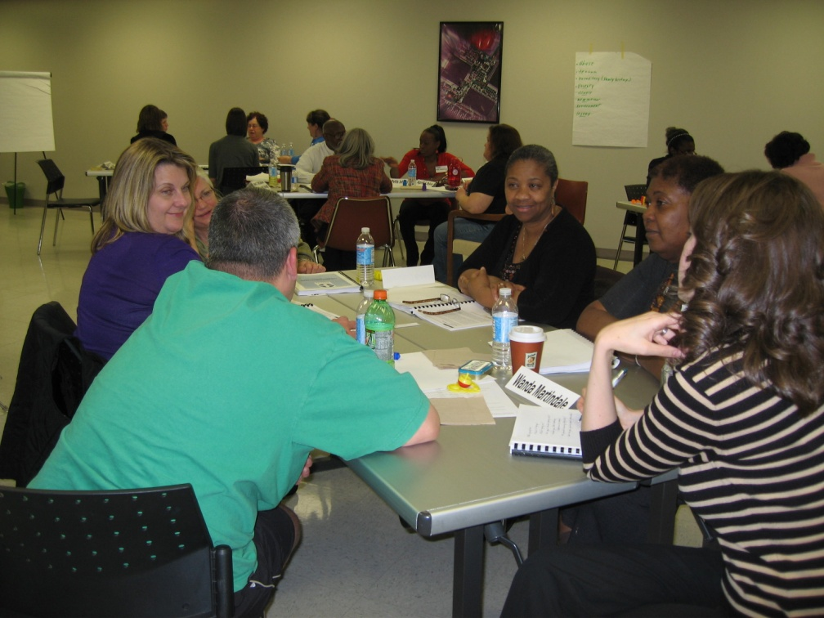
MHFA -How can I get it?
12 or 8 Hour MHFA course
  Contact an instructor
  Move forward
  Practice what has been learned

Slide 53
MHFA Training Rates

Slide 54

Mental Health First Aid USA
Contact:

