Slide 1
CONTACT USA
CONTACT USA (CUSA) is a network of crisis intervention centers across the nation. Conceived in 1967 as a response to the growing social issues of a changing nation, CONTACT has grown and evolved into a network of over 50 centers in 20 states, exploring new ways in which to serve their individual communities.

Slide 2
CONTACT USA
Mission
Providing leadership and support to centers that provide helpline services to people in crisis or need
Vision
The leadership and support Contact USA provides will enable member centers to thrive and provide professional, effective service
Values Statement
We value and respect all human beings. We reach out in compassion to ease human suffering. We believe in the effectiveness of trained volunteers and staff

Slide 3
Board of Directors
Mary Drexler, Executive Director
Board:
Tim Jansen, Community Crisis Services, Maryland – Chair
Molly Brack, Agora Crisis Center, New Mexico
Eleanor Letcher, Treasurer, CONTACT of Mercer County, NJ
Becci Reedus, Iowa City Crisis Center, Iowa
Dorothy Triplett, Johnson County Crisis Center, MS
Brenda Patterson, Johnson County Crisis Center, MS
Marshall Ellis, National Suicide prevention Lifeline, NYC
Virginia Bainbridge, Member at large, CT

Slide 4
Crisis Chat :Who is it for?
Crisis Chat is for anyone who is going through a hard time and just needs to talk, including people who are thinking about suicide.
It’s for anyone who may be experiencing depression, anxiety, relationship problems, family stressors, abuse, financial issues, and more.
It’s for anyone looking for a compassionate connection when they are feeling most alone.

Slide 5
Online Emotional Support/CHAT Defined
Online Emotional Support is NOT:
  Counseling
  Therapy
Online Emotional Support (OES) IS:
  Compassionate, non-judgmental listening
  Exploration of thoughts and feelings
  Exploration of positive next steps and options
Other terms used going forward:
  Visitor: the individual requesting services
  Chat Specialist: the staff member/volunteer providing services

Slide 6
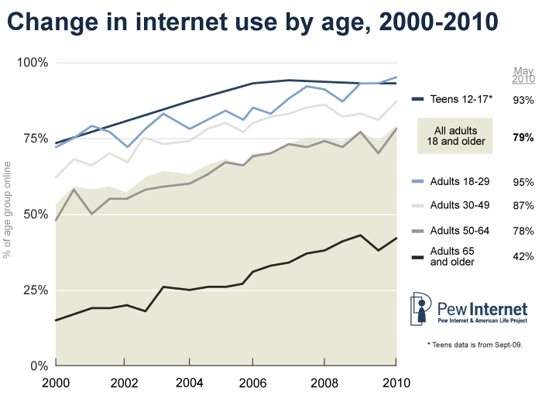
Trends in Internet Usage

Slide 7
Internet Used as an Emotional Outlet
People in distress are reaching out online: Facebook, Twitter, Craigslist postings, personal blogs, e-mails to crisis centers
Why?
    convenience
    anonymity (awkward conversations that would be difficult to have in person)
    stigma/shame of asking for help from a crisis center
    lack of confidence and/or verbal acuity to express emotions and ask for help
    “testing the waters” to see if anyone cares
“Online disinhibiting effect”: the tendency of people to open up more and say more about themselves online than they would over the phone or face-to-face

Slide 8
The OES Response
OES services, such as Chat, provide a safe online venue where people can reach out for help.
Engaging populations traditionally hard to engage face-to-face.
OES services aim to:
  Provide people with tools to make better health/life decisions
  Increase culturally relevant access to support for current and emerging generations
  Decrease stigma associated with accessing treatment/support services
Notes:
A task force convened in May 2009 at the annual CONTACT USA conference in Chicago. It was there that this group started thinking about how to create a national network of crisis centers to provide OES services.

Slide 9
Chat Specialist & Visitor Expectations
Chat Specialist:
The average chat can last 20-30 minutes.
High risk chats sometimes take 1 hour or more.
Visitor:
Visitors are unfamiliar with the service and may not understand what it provides, but also its limitations.
When necessary, provide the Visitor with information on chat format: discussion of issues and options for support.
While you want to be patient and allow for conversations to unfold, it’s also important to not allow the Visitor to cover every single issue they have; help them focus on their main concern.

Slide 10
Etiquette on Chat
Respond promptly to a Chat Visitor and expect the same from them.
Answer a request for chat as promptly as possible but not longer than two minutes.
Do not use slang in conversations; maintain professionalism (use emoticons sparingly).
Use correct punctuation and minimize spelling errors.
Refrain from joking with the Visitor. There is more chance for miscommunication in the absence of verbal tone, so it is more difficult for the visitor to tell if you are kidding, tongue-in-cheek, serious, sarcastic, etc.
Do not type in ALL CAPITALS – it is called “shouting” and is considered to be rude.

Slide 11
Chat Timing
  Jumping too far ahead:
  A Specialist may use too many questions, or may move too quickly toward “problem solving”.
  Using open-ended questions, validation and empathy at the beginning of a chat will allow the Visitor to express the issues that brought them to chat.
Chat segments:
  Not too short, but too long.
  Come to a happy medium with your “chat segments,” matching the Visitor’s style, if appropriate.
Out of sync communication: a Visitor’s response to a question may come after they’ve provided additional content.
    This is common in chat settings. It’s ok to clarify which answer corresponded to which question and other potentially confused meanings.

Slide 12
High Levels of Disclosure
Online disclosure is high and many topics are often disclosed at once.
  Visitors may not answer questions because they are busy typing out more details.
  There may be a very high need for the Visitor to “vent” for a long period of time.
Assertiveness and Use of Repeating Questions:
  Be assertive (not aggressive) in directing the flow of the chat at all times.
  Help the Visitor focus on one issue at a time.
  Repeat questions if the visitor does not answer the first time.

Slide 13
Abrupt Endings on Chat
Transient and Unconnected Nature of Chat
The flip side of the online disinhibiting effect:
  While it is easier for Visitors to disclose in an online environment, it is also much easier for them to disconnect (lower feeling of responsibility to the relationship/ easier to leave someone you cannot see).
It can be hard to have a chat end without resolution especially as we have no way of “calling back” Visitors that have not given us contact information.

Slide 14
Suicide Risk Assessment
Risk assessment takes longer on chat.
Asking all the questions may need to be woven in many sections of the chat. If resistant at first, come back to them later.
Preface with a leading statement in text-based communication.
Stay focused on the questions you need to ask.
Begin the risk assessment as soon as a comfortable rapport has been established, as chats can unexpectedly end at any time.

Slide 15
High/Imminent Risk on Chat
Chat Visitor Location
For each visitor we have an Internet Protocol (IP) address, which is the unique virtual address for each computer.
This is not always traceable back to a computer – for example, if it is part of a University or Wi-Fi network.
Chat to Phone
You may be able to turn high risk chats into phone conversations. You should have an internal protocol on how and when to turn a chat into a phone call.

Slide 16
Facilitating Active Intervention
“Active Intervention” is much more difficult online without the cooperation of the Visitor.
If risk of harm is suspected, attempt to collect identifying information:
      full name
      phone number
      address
      emergency contact
Obtain the Visitor’s IP address (can be gotten from the chat software itself)
Contact local authorities when police intervention may be necessary.

Slide 17
Staffing Considerations
What Makes a Good Chat Specialist?
Good Phone Specialists can make good Chat Specialists: empathetic, non-judgmental, open-minded, intelligent and able to follow center protocol.
However, also need to be able to:
  type quickly with few errors,
  be comfortable with technology,
  be assertive (rephrasing, guiding the flow of the chat)
  be patient (without rushing into “fix” mode)
  have an affinity for nuance-catching words that can be ambiguous and are able to explore for further meaning
  remain relaxed throughout intense chats.

Slide 18
Visitor Feedback
“I have gotten a lot of support here. I would go as far as to say they have saved my life.”
“This service has been a great help to me. It is a great alternative when you can't or don't feel comfortable talking on a phone. I know I've tried to call the suicide hotline three times, but panicked each time, so this is perfect for me.”
“Being in my current situation I have no support, it was nice to have or feel as though someone was on my side.”
“I was really relieved to see this service existed cause I hate talking on the phone.”
“I think this is an incredible service and resource for those of us who are suffering and just need someone to listen to us.”

