Slide 1
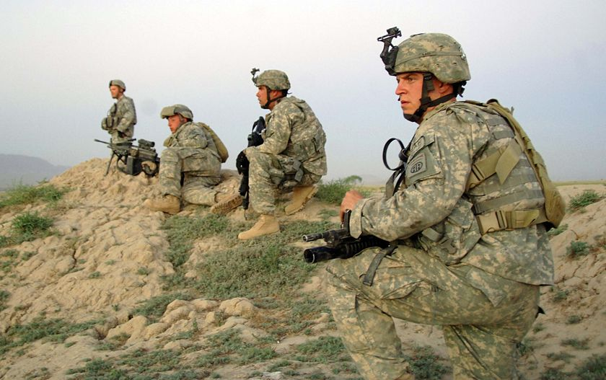
Connecticut Army
National Guard
Behavioral Health Team

Slide 2
Connecticut Army National Guard Behavioral Health Team
Behavioral Health Team
MAJ J. Alvarado
Susan Tobenkin
Michael Dutko
SGT Kristy Soucy
CTARNG Prevention Coordinator
SFC Claude Campbell
Suicide Prevention Program Officer (SPPO)
CPT Musgrave

Slide 3
Objectives
Current Picture CTNG
Behavioral Health Team Mission
Deployment Cycle Support
Suicide in The Military
Suicide in The CTNG
Suicide Prevention Efforts
Sub Committee Objectives

Slide 4
Connecticut Army National Guard
Overview
The CTARNG
Current Strength CT National Guardsmen - 3589
Male / Female – 3,035 / 554
Average Age of CTARNG Soldier – 29
Age:
17 – 25: 1,487
26 – 35: 1,130
36 – 50: 789
51 > 183
Combat
Currently 609 deployed
Total Soldiers deployed since 11 Sep 2001 over 4,000
Multiple Deployments (2-4)
Common issues
BH Issues / Adjustment
Financial stressors / Employment
Relationship - Family / Marital / Significant Others
Substance Use
Active Army vs. National Guard

Slide 5
BH Mission
The Connecticut National Guard Behavioral Health Team (CTNG BHT) is a medical readiness team providing quality behavioral health (BH) assessments, screenings, education, prevention, training, case management, command consultation, support, and treatment referrals to ensure that every Connecticut service member receives the timely BH care they need and in doing so maximizing total force fitness.

Slide 6
Deployment Cycle Support
ALERT:
Soldier Readiness Process (SRP)
90, 60 30 Prior
Routine:
Periodic health Assessments (PHA)
Behavioral Health Assessments & Screenings:
PHQ, TBI, GAD, PTSD, Mood Disorders Questionnaire
Substance Abuse Screenings:
PHA / SRP’s
CAGE, DAST, AUDIT
Post Deployment Health Re-Assessments
Case Management

Slide 7
Suicide in The Military
Branch | Suicides In 2011 | Suicide Attempts 2011
Total | 301 | 915
Army | 167 | 432
Air Force | 50 | 241
Marines | 32 | 156
Navy | 52 | 86
This number includes deaths strongly suspected to be suicides that are pending final
determination
Of the 915 Service Members who attempted suicide, 896 had one attempt, 18 had
two attempts, and 1 had three attempts.

Slide 8
Suicide in The Military
The majority of deaths by suicides were by Regular component Service Members (88.70%), followed by the National Guard (7.31%), and Reserve (3.99%).
Compared to suicide decedents, a larger percentage of Service Members who attempted suicide were under the age of twenty-five (57.22% of suicide attempts, 37.87% of decedents).
Service Members most frequently used firearms to end their lives (59.93% for all firearms, 49.13% for non-military issue firearms
Drug overdose was the most frequent method for suicide attempt

Slide 9
Connecticut Army National Guard
6 Confirmed Deaths By Suicide in CT In Last 24 Months
1- Substance Related (RX/Illicit)
3- Guns
1- Hanging
1- Asphyxiation - Helium

Slide 10
Suicide Prevention Efforts
ACE Program
Applied Suicide Intervention Skill Training (ASIST)
Comprehensive Soldier Fitness
Focus 5 dimensions
Master Resilience Trainers (MRT’s)
Resilience Training Assistants (RTA’s)
Suicide Prevention Program Manager (SPPM)
Suicide Prevention Briefings (Yearly Mandatory)
Reduce the stigma associated with seeking help
Encourage leaders to connect with and know their people and reach out to help them when necessary
Demonstrate the importance of resilience in preventing suicide throughout the entire Army Family
Understand stressors and high-risk behaviors that can lead to psychological distress and suicide

Slide 11
Suicide Prevention Video

Slide 12
Sub Committee Objectives
Review current suicide prevention efforts
Enhance Postvention Efforts
Collaborate With Community Resources – Access By Veterans
Identify/Develop Best Practice For Suicide Prevention

Slide 13
Resilience, Risk Reduction, and Suicide Prevention (R3SP) Task Force
The Army National Guard (ARNG) established a Resilience, Risk Reduction, and Suicide Prevention (R3SP) Task Force to synchronize ARNG health promotion and risk reduction efforts, including procedures to review, assess, and manage Task Action Plans (TAPs) developed in conjunction with the Army's Health Promotion and Risk Reduction Council (HP&RRC). The R3SP Task Force in CT meets on quarterly basis in order for leaders to direct actions necessary to implement immediate but enduring solutions that will promote resilience amongst our SMs and family members.

