Slide 1

Housing & Homeless Services in Connecticut
October 2024
Mollie Machado, Program Manager
Dept of Mental Health and Addiction Services, Office of the Commissioner, Statewide Services Division
Notes:
Thank you for letting me join today!
Excited to be here – looking forward to sharing some information with you all, and hopefully helping to answer questions. Have about a dozen slides and a high-level overview, but happy to dig in!

Slide 2
Causes of Homelessness
Lack of Affordable Housing
Lack of Prevention Supports
No social supports
Prolonged institutional stays (hospital, incarceration, residential treatment)
Limited Income
Notes:
Really want to highlight here that while there are definitely choices that people make that can result in homelessness eventually, the root causes of homelessness are systematic. If we had a more robust safety net and prevention system, far more people could avoid the trauma of homelessness.

Slide 3
How many people are housing insecure?
Our best data on housing insecurity statewide comes from 211, where housing calls are their most frequent inquiries.
From July 1, 2023-June 30, 2024 211 received 539,190 requests for housing and shelter related calls.
Because most federal resources are reserved for folks experiencing homelessness, there are very limited resources for folks at-risk of homelessness. HUD has very strict definitions of homelessness, and as the funder, our programs can only serve eligible populations.

Slide 4
HUD Definition of Homelessness
Literally Homeless*
  Living in a shelter, place not meant for human habitation (unsheltered), hotel paid for by government or charity, or in an institution for 90 days or less, and was in one of the other settings the night before the institutional stay.
Imminent Risk of Homelessness
Homeless under other federal statutes
Fleeing or attempting to flee domestic violence*
Most of the homeless service programs in CT can only serve folks who are literally homeless or fleeing DV, per funder regulations

Slide 5
Connecticut’s Point In Time Count of People Experiencing Homelessness
There were 3,410 people experiencing literal homelessness on the night of the count this January.
That is a 13% increase from the prior year count of 3,015 people.
This includes families with children, individuals, folks staying in shelters, and folks who are staying in places not meant for human habitation.
For more info, see PIT-2024-Nutmeg-Final-Report_2024.07.30.pdf (ctbos.org)

Slide 6
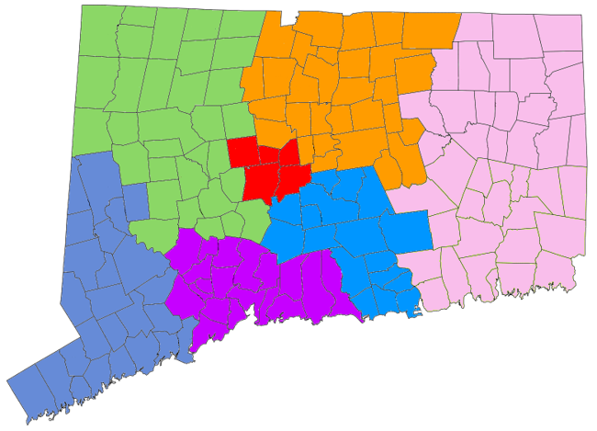
CAN Map
Notes:
State is divided into 7 Coordinated Access Networks, or CANs. These are the regions where homeless services are provided. Within each region 211, the Hubs, street outreach teams, emergency shelters, and housing programs all work together to help households exit homelessness as quickly as possible. Regions were initially determined based on data showing where people tended to move around while experiencing homelessness – doesn’t match DCF, DMHAS, county lines etc.

Slide 7



CAN System Overview 2023
A high-level diagram of the coordinated access process from points of entry to points of exit
Diverted from Homelessness
Rapid Exit from Homelessness
1 - At Risk or Not Yet Engaged – Households in this phase are either at risk of homelessness or have not yet been engaged by Outreach
2 - Literal Homelessness – All households in this phase are included in the active category of the By Name List (BNL)
3 – Exits to Housing – Households self-resolve and are connected to housing resources by CANs
Emergency
Shelter
Housing Solutions Meetings in each CAN utilizing the active category of the BNL
Self-Resolved
youth
families
individuals
CAN HUBs
Rapid Rehousing
2-1-1
eligibility screening
Street Outreach
At risk of homelessness
On Shelter
Priority List
Permanent Supportive Housing
Shared Housing
Living outdoors or another place not meant for human habitation
Notes:
There are a couple of ways that people move through the system. When anyone is having a housing crisis, we want to encourage folks to call 211. This is because 211 will screen for a few things (is this person currently experiencing domestic violence? If so, they’ll direct to that system of care. Is this person a veteran? There are veteran-specific services to refer to. Could this person’s housing crisis be resolved with utility assistance? Let’s get them connected to that instead of referring them into the homeless services system).
If 211 can’t resolve a crisis over the course of that initial call, they will then direct folks to their local Hub – these are locations staffed with folks who do housing problem solving. There is financial assistance available for households who have income, to prevent them from entering the system. This can look like first-month’s rent, but could also be things like assistance to relocate back with their natural support network (if they are new to CT. Staff always call family/friends in other area to confirm that people are able to stay with them for at least a month before helping folks relocate).
If people are residing outside, on the street, or in another place unfit-for-habitation, our street outreach teams can also help them connect in. Outreach teams do not need to call 211 to start helping someone – they can have housing conversations out in the field and can add folks to local shelter waitlists immediately.
Unfortunately, in Connecticut emergency shelters are nearly always at capacity. Shelter capacity has reduced since the pandemic, and communities are very resistant to creating additional shelter space. All CANs operate a shelter waitlist, which is accessed through either the Hubs, or homeless outreach teams. The goal is to keep folks out of shelter if they can be diverted, which is what the focus of CAN appointments are at the Hubs.
Once people have been identified either by outreach teams, or are in a shelter, they are automatically added to the local By-Name List of housing resources. This includes Rapid ReHousing (time-limited rental assistance with case management) as well as longer term supports, like Permanent Supportive Housing. All resources are prioritized based on how long folks have been literally homeless, and the most intensive programs are specifically for folks who have a disabling condition (don’t have to get SSI, but need to have a condition that impairs their ability to live independently – can be SMI or SUD or a physical condition, or HIV/AIDS, or a developmental disability). All housing resources go through the By-Name List, and unfortunately there are not nearly enough resources for everyone in the system to get connected to one. There is a persistent myth that if you enter shelter you will get a voucher, but the reality is that if you have not been homeless for more than a year, you will not be prioritized for those resources, because we try to serve the most vulnerable folks first. Other options, like one-time assistance with a security deposit, or shared housing (roomates!) are other ways that folks are able to exit homelessness. Our service providers make referrals to benefits assistance as well as employment programs to try and help folks increase their income.

Slide 8
Services for People Experiencing Homelessness
Outreach Workers – support folks who are unsheltered in meeting basic needs like food and safety, work towards housing
Diversion – Financial assistance and mediation to prevent people from entering homelessness
Shelters – Places for folks to stay while they are experiencing homelessness – most communities operate waitlists for shelter
Notes:
-mention the recent re-bid of DMHAS homeless outreach, we have 4 different outreach programs working as teams around the state. (PATH, SNOFO, Statefunded, T-HOP)
-also flag that other services exist like SOAR, supported employment, and of course all the treatment resources around the state.

Slide 9
Housing Supports
One Time Assistance/ Rapid Exit – financial assistance like a security deposit or one month’s rent to help folks exit homelessness
Rapid Re-Housing – Time-limited rental support with case management services available
Supportive Housing – non-time-limited subsidy, where participants contribute 30% of whatever income they have towards rent, and the voucher pays the remaining rent. Case management services are available.
There are dramatically more people experiencing homelessness in CT than there are housing program openings.

Slide 10
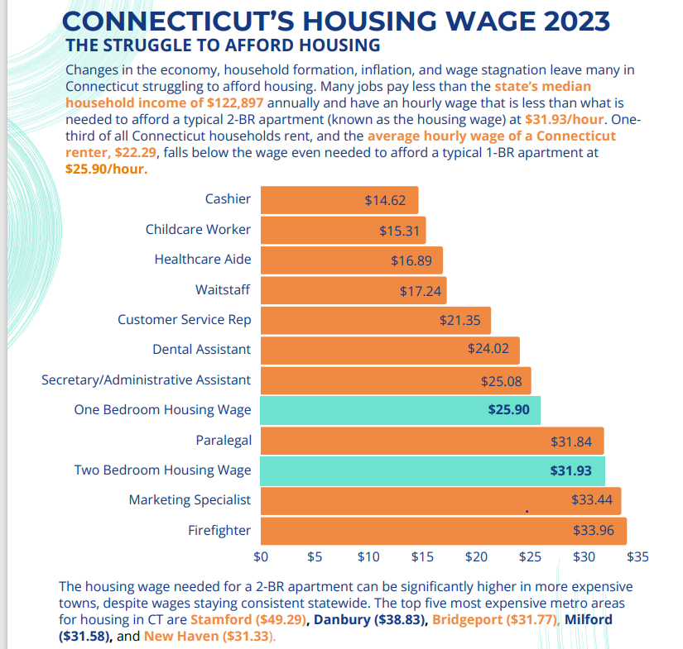
For more info, visit:
Housing Data – Partnership for Strong Communities (pschousing.org)

Slide 11
Impact of homelessness
Homelessness is extremely traumatic. The uncertainty of not knowing where you will reside, sometimes where you will eat, who you will interact with, impacts all areas of life.
The number one predictor of homelessness is a past experience of homelessness. Children who spend time in shelters are more likely to experience homelessness as adults.
Homelessness is most often a result of all other safety nets failing, so for many people they have already experienced systemic trauma, and ultimately still became homeless.

Slide 12
How to help
The best way to help folks in a housing crisis is to try and help prevent homelessness. This can include trying to help mediate with a landlord, seeking out additional income, connecting them to supported employment programs or additional benefits, helping them identify family and friends.
If people are in need of shelter, help make the initial call to 211. Learn where the Hubs are in your community so you can help make warm handoffs.
If you are ever working with someone who is unsheltered, reach out to local homeless outreach providers.
Notes:
I would LOVE to help folks on this call make connections to the local service providers in their area. The CAN system was built up to try and encourage cohesion amongst housing and shelter providers, but an unintentional consequence is that these providers got less connected with other community partners. To me, you guys are all a part of the emergency system, and should know how to help get people connected. ESPECIALLY people who may be struggling with the “standard” process!

Slide 13
Homelessness is Systemic
People experience homelessness because of many interrelated factors, but it’s important to recognize a housing crisis isn’t about individual failure. Housing costs dramatically outpace minimum wage in CT, and housing stock is extremely limited. The services we have to support people experiencing homelessness have not kept pace with the inflow of people experiencing housing crises. Talking to your own community about what is being done to increase housing options is another piece of this puzzle.

Slide 14
Questions?
Feel free to reach out to mollie.machado@ct.gov 860-941-9451

